Slide 1
NSWC Crane Printed Electronics
Presented by: Steve Vetter
CAPT Mark Oesterreich, USN
Commanding Officer
Dr. Brett Seidle, SES
Technical Director
Distribution Statement D: Distribution authorized to the Department of Defense and U.S. DoD contractors only.
Statement A: Approved for Public Release; Distribution is unlimited.

Slide 2
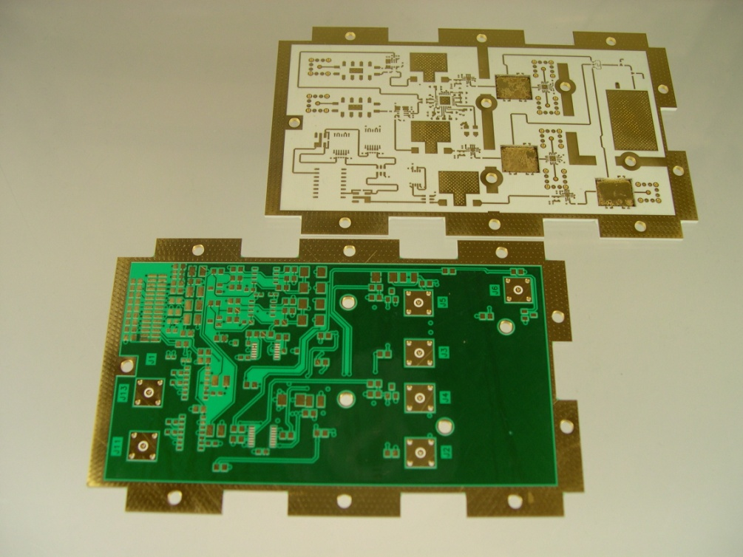
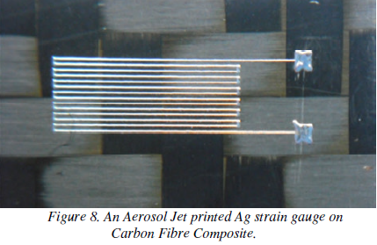
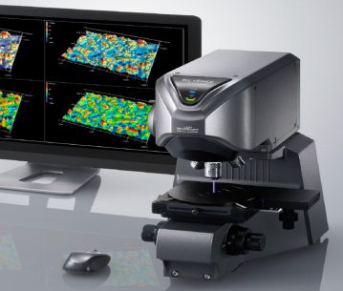
Agenda
PCB Manufacturing
Printed Electronics
Activities and Projects
Distribution Statement D: Distribution authorized to the Department of Defense and U.S. DoD contractors only.

Slide 3
Agenda
PCB Manufacturing
Printed Electronics
Activities and Projects
Distribution Statement D: Distribution authorized to the Department of Defense and U.S. DoD contractors only.

Slide 4
PCB Manufacturing - Facility
Facility:
Fully government owned and operated
Secure
Entire fabrication facility is a restricted access area
Cleared to Secret
16000+ square feet
Class 10K controlled environment cleanrooms
Zero discharge waste treatment system
Distribution Statement D: Distribution authorized to the Department of Defense and U.S. DoD contractors only.

Slide 5
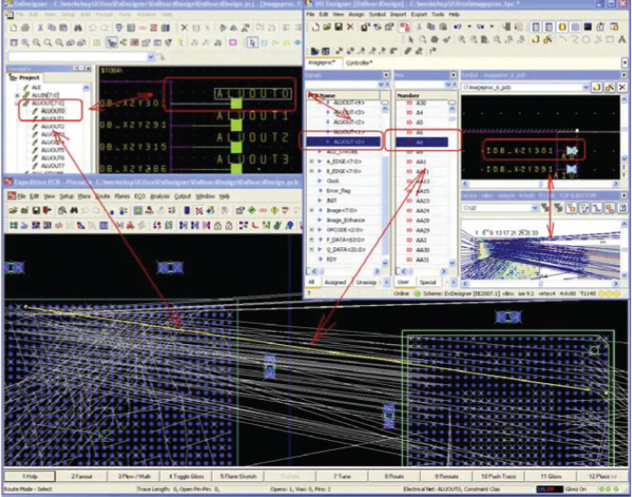
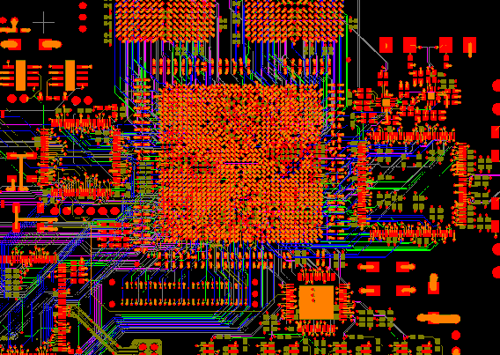
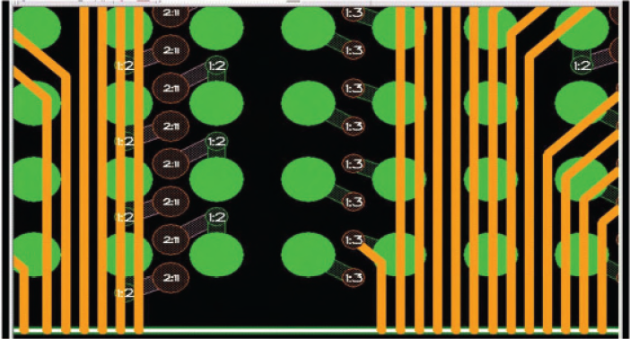
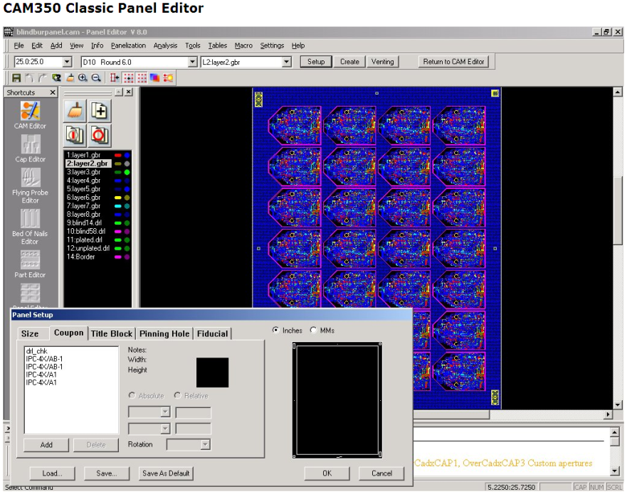
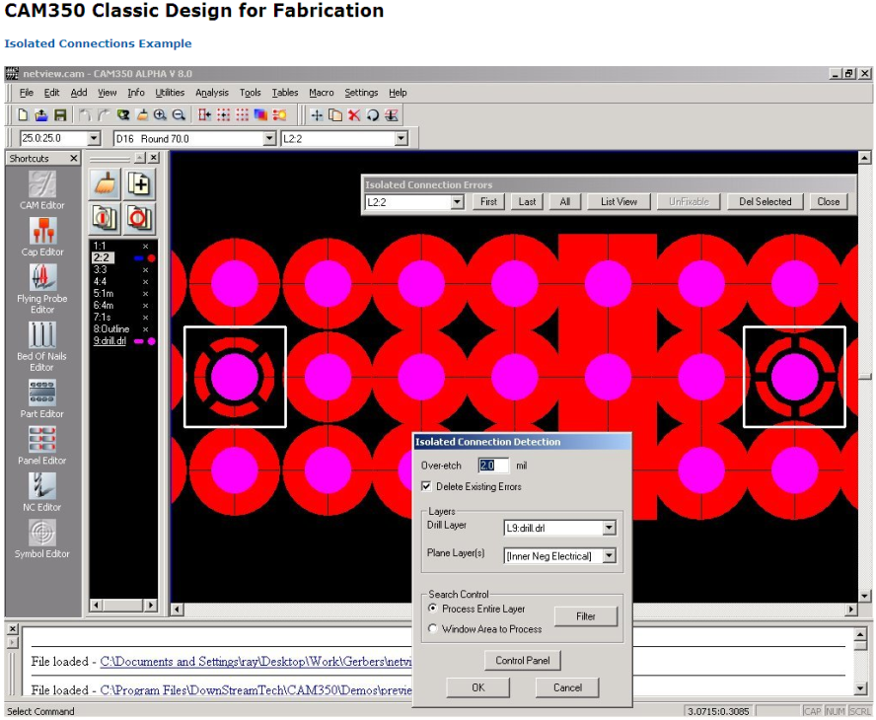
PCB Manufacturing - Design
CAE Tools:
Ansys SiWave
Ansys IcePak
Polar Speedstack
Admunson Arkeo Stack
CAD Tools:
PCB Layout:
Altium
Mechanical:
AutoCAD
FeatureCAM
MasterCAM
Solidworks
CAM Tools:
PCB Tooling:
Downstream CAM350
UCAMCO UCAM
Reverse Engineering:
ScanCAD
Distribution Statement D: Distribution authorized to the Department of Defense and U.S. DoD contractors only.

Slide 6
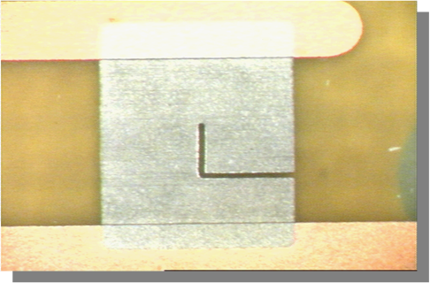
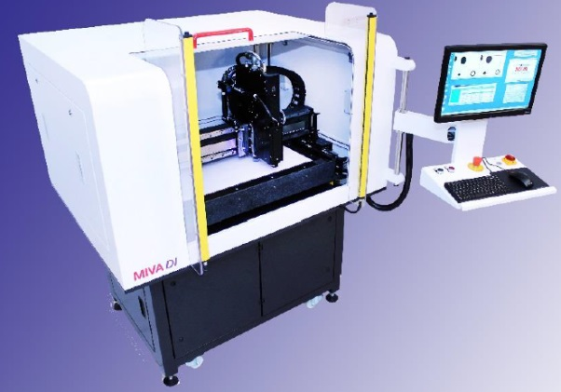
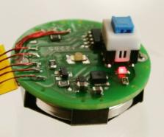
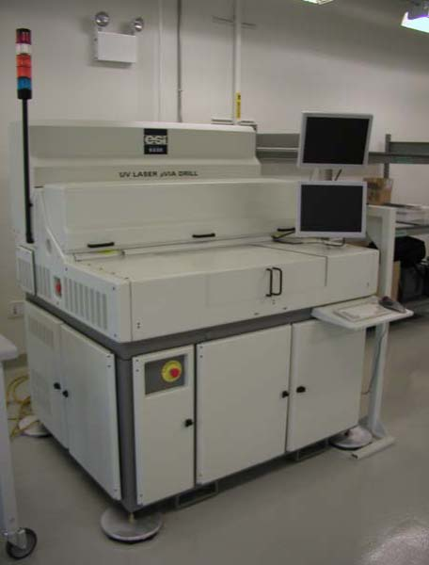
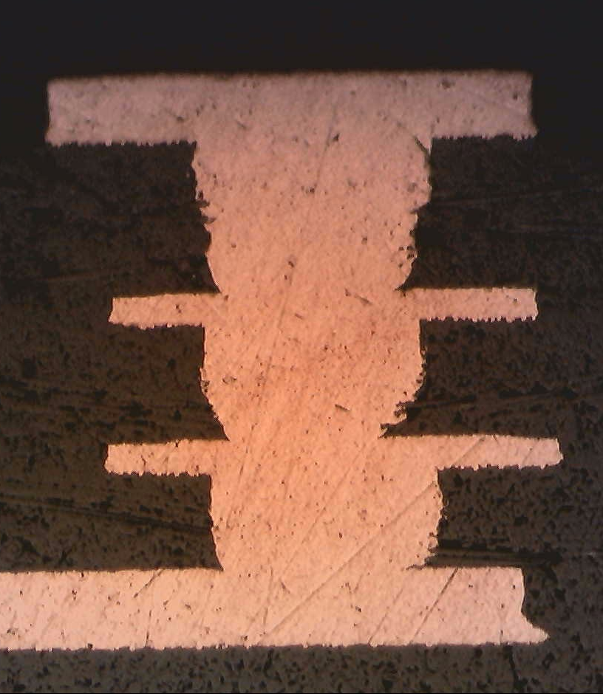
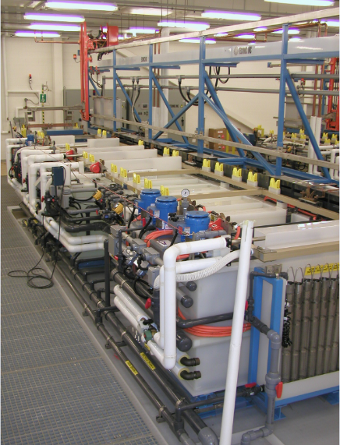
PCB Manufacturing - Capability
Multilayer:
20 layers + Ridged
Sequential lamination
Buried and blind vias
Stacked/staggered microvias
High Tg FR4, Teflon, Polyimide
Embedded passives
Flex / Ridged Flex:
8 layers +
Multiple ridged sections
Pyralux, LCP
High Density Interconnect: (in development)
12.5 micron features
Multilayer / sequential lamination
Embedded active and passive
Substrate / interposer / RDL
Distribution Statement D: Distribution authorized to the Department of Defense and U.S. DoD contractors only.

Slide 7
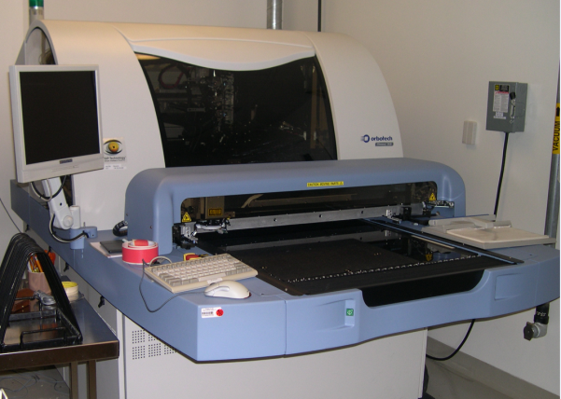
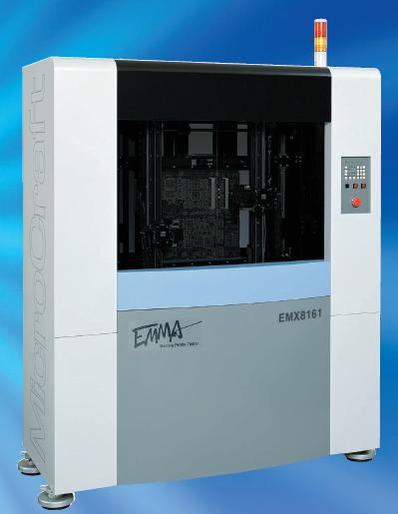
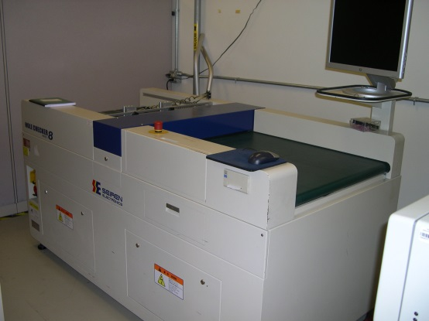
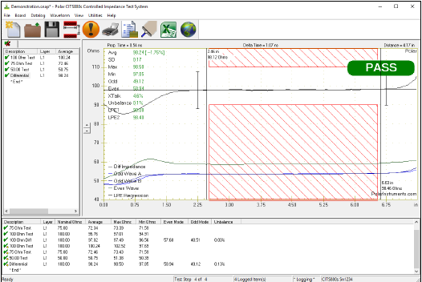
PCB Manufacturing - Test
Electrical Test
Microcraft EMMA 6161 flying probe
Polar CITS880s Impedance Tester
Hipot Tester (AC/DC/IR) - Sentry 30 Plus (500V)
Inspection
Orbotech Discovery OLB Automatic Optical Inspection System
Siren Hole Checker drilled hole inspection system
CMI Plating thickness measurement
Olympus and Zeiss Metallurgical Microscopes
Distribution Statement D: Distribution authorized to the Department of Defense and U.S. DoD contractors only.

Slide 8
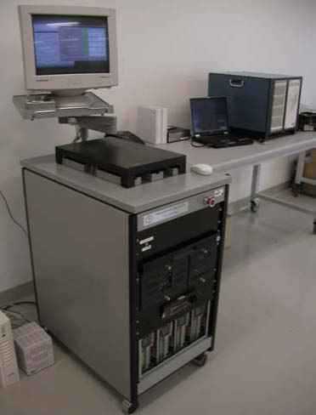
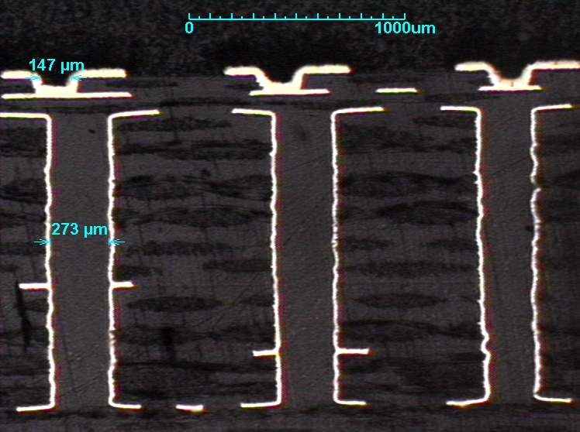
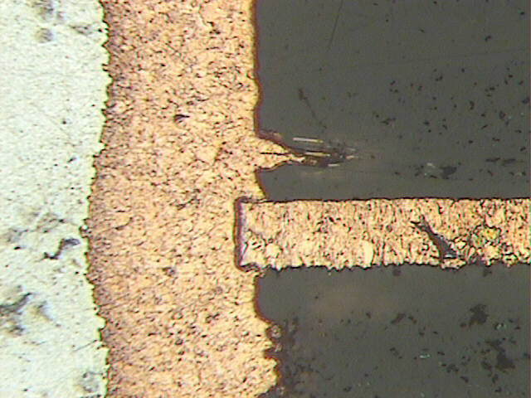
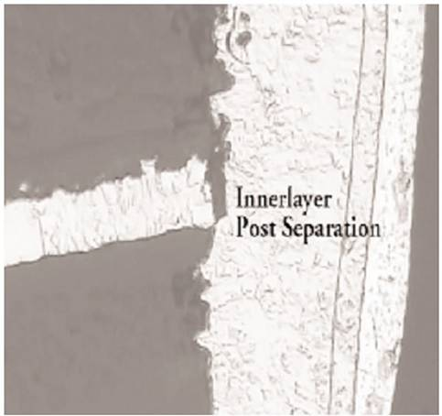
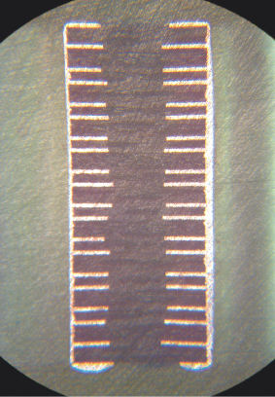
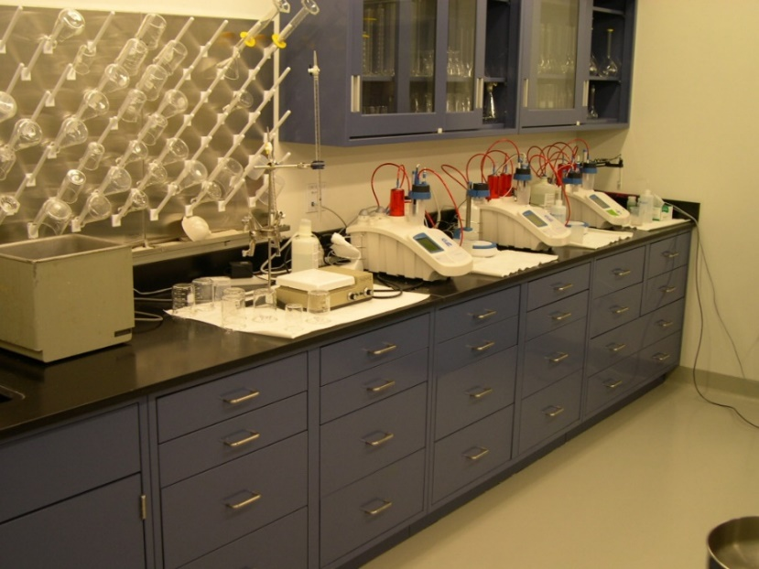
PCB Manufacturing – QA and Reliability
Quality Assurance:
Microsection
Visual / mechanical Inspection
Interconnect Stress Test (IST) - IPC TM650 2.6.26
Insulation Resistance Testing (SIR)
Environmental
Temperature / humidity cycling
Vibration
IPC 600/610 Class 3 Certified
Bowman XRF
Analytical Lab:
Auto - titration
UV VIS
Over 300 process controls
Distribution Statement D: Distribution authorized to the Department of Defense and U.S. DoD contractors only.

Slide 9
Agenda
PCB Manufacturing
Printed Electronics
Activities and Projects
Distribution Statement D: Distribution authorized to the Department of Defense and U.S. DoD contractors only.

Slide 10
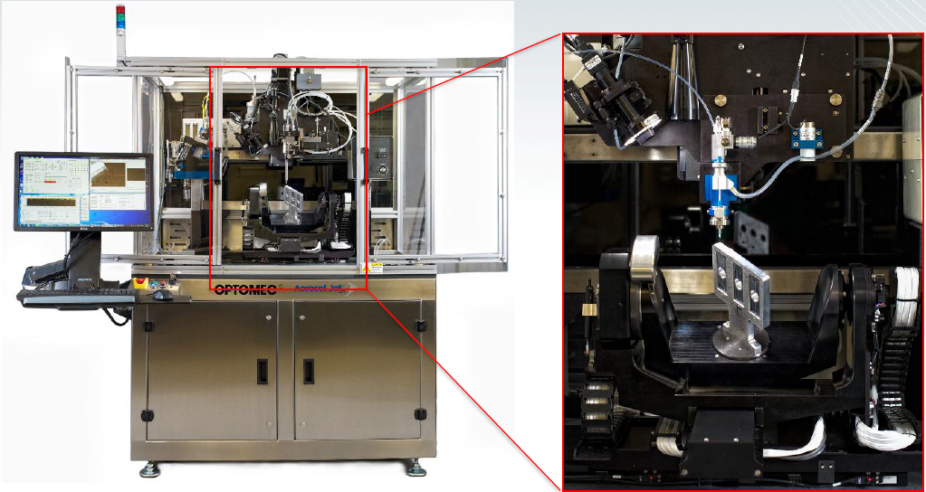
Printed Electronics
Optomec AJ-5X Aerosol Jet Printer
Full 5-axis 3D printing of conductive and dielectric inks
Conformal circuitry
Fully additive interconnect fabrication
Embedded active devices
Printed / conformal antennas and sensors
Distribution Statement D: Distribution authorized to the Department of Defense and U.S. DoD contractors only.

Slide 11
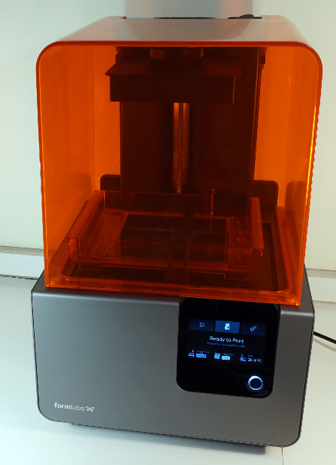
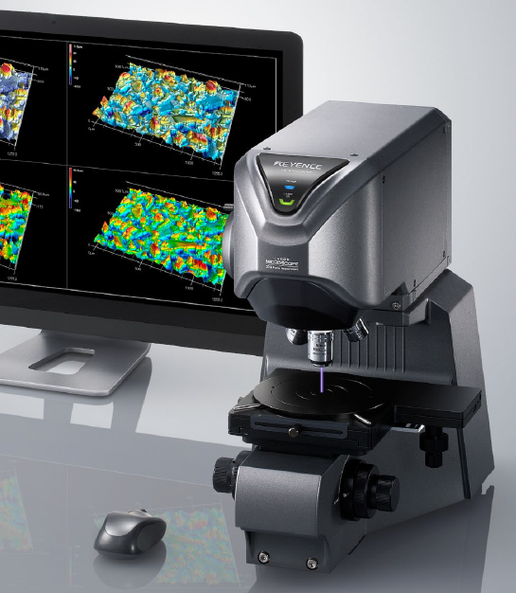
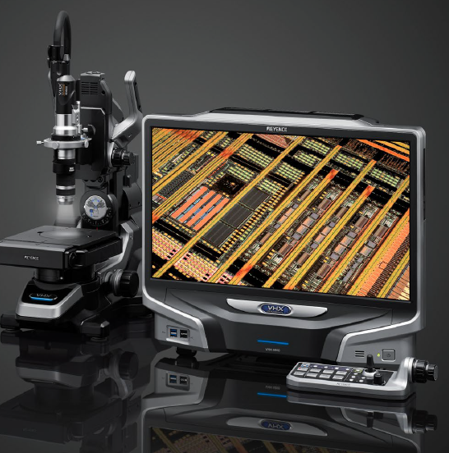
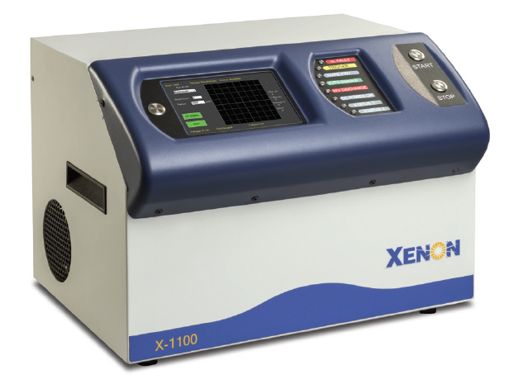
Printed Electronics
Printed Electronics Lab :
FormLabs Formed2 SLA 3D Printer
Voltera V-One
Botfactory Squint
LPKF U3 Protolaser
Digital 3D Microscope 2000x magnification
Laser 3D Confocal Microscope 5nm resolution
Ink Development
Planetary Ball Grinder
Viscometer
4plc analytical scale
Potentiostat
Fume hood
Spin coater
Vacuum Oven
Photonic sinter
system
Distribution Statement D: Distribution authorized to the Department of Defense and U.S. DoD contractors only.

Slide 12
Agenda
PCB Manufacturing
Printed Electronics
Activities and Projects
Distribution Statement D: Distribution authorized to the Department of Defense and U.S. DoD contractors only.

Slide 13
PCB and PE Fusion
Explore potential solutions by combining the best of traditional PCB manufacturing with Additive Printed Electronics
Utilize unique combination of capabilities at Crane
Areas of Investigation:
Planar embedded die interconnects (Direct Write)
Localized high density packaging fan out
Counterfeit Mitigation Technologies
Tamper Mitigation Technologies
Distribution Statement D: Distribution authorized to the Department of Defense and U.S. DoD contractors only.

Slide 14
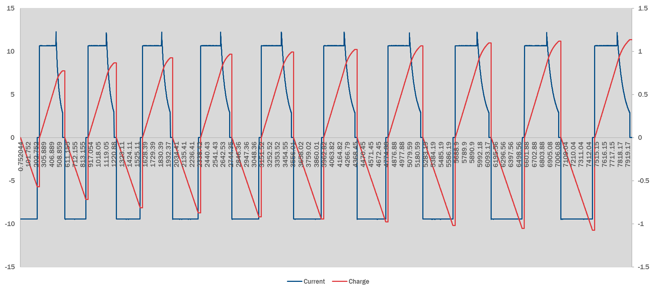
Printed Silver/Zinc batteries
Prototype batteries to test inks
Linked in series to power 2V LED
Battery Printed via Optomec
High internal impedance
Can be solved with different design
Cycles well but low charge storage
More “fingers” of reduced size will
Result in higher charge
Only possible to print this design
Using the optomec
Silver/Zinc batteries
1.6V max charge
1.56V working charge
Good cycling ability
Prototypes can be cycled 20 times before decay of charge
Main issue is electrolyte storage and delivery and separator failure
Distribution Statement D: Distribution authorized to the Department of Defense and U.S. DoD contractors only.

Slide 15
Printed Sensors
3-D printed flexible sensors for use in detection of environmental changes and agent detection
Sensors are printed using Optomec instrument or using graphite based inks
Polymeric coatings induce a capacitance change when encountering a chemical element
Allows for the fabrication of lightweight, low-power, flexible sensors
Distribution Statement D: Distribution authorized to the Department of Defense and U.S. DoD contractors only.

Slide 16
Printed Sensors
Sensor Designs
Can be capacitance or resistance based
Top and middle designs are silver printed via Optomec and then coated in a respective polymer
Can suffer from hysteresis depending on polymer
Leads to flexible humidity sensor
Bottom design is a thin polymer film coated in graphite
Good repeatability if hydrophobic polymer is used
Gen 1 and Gen 2 thermal sensors
Constructed from printed silver
Resistance based
Can be coated in protective polymer
Highly repeatable readings
Flexible
Distribution Statement D: Distribution authorized to the Department of Defense and U.S. DoD contractors only.

Slide 17
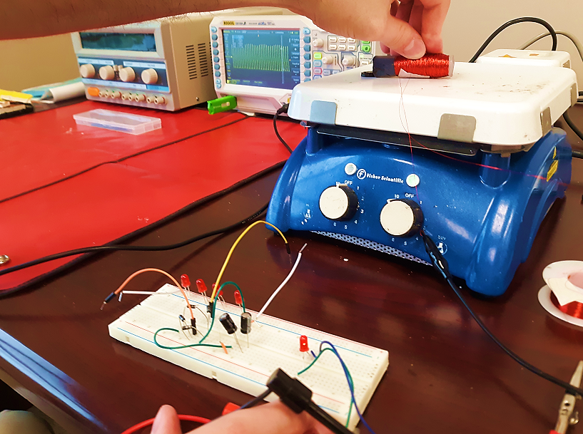
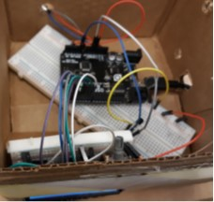
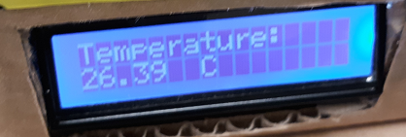
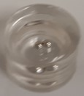
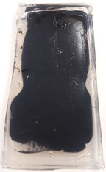
Ferrofluid Energy Harvesters
Objective
Develop flexible/wearable energy harvesters for realizing self-powdered flexible electronics
Desired characteristics: small, flexible, stretchable
Use a printed battery /supercapacitor or other energy storage devices to ensure energy harvesting flexibility and power supply stability/reliability
Current status
Parameter modeling is performed to optimize the variables (such as wire windings, magnetic positioning, vibration amplitude and frequency, ferrofluid properties) for tuning output voltage of flexible ferrofluid energy harvesters
Three ferrofluids have been formulated to match with different sizes/shapes of magnets as the magnetic media
Several energy harvesters have been developed generating output voltages up to 30 volts; have illuminated an array of LED lights; and have powered thermal sensors.
Next step
Fabricate thin planar flexible ferrofluid energy harvesters suitable for the frequency range from 1 to 60 Hz
Develop assembly process to integrate the energy harvester to the flexible/wearable electronics
Illuminate LED
Power a thermal sensor
Flexible chamber energy harvester designs
Distribution Statement D: Distribution authorized to the Department of Defense and U.S. DoD contractors only.

Slide 18
Common FHE Sensor Architecture
Wireless Data Link
Stimulus
Blue Tooth
µCtlr
ADC
Sensor
Element
Thinned active die
Flexible substrate
Printed interconnects and passive components
Common Backend Architecture
Distribution Statement D: Distribution authorized to the Department of Defense and U.S. DoD contractors only.

Slide 19
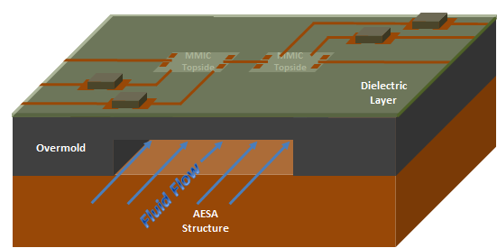
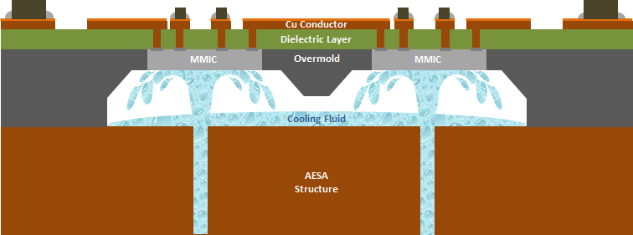
Advanced Additive Packaging
Liquid Cooling Application
Enables cooling fluid to be in direct contact with HPA MMIC
May enable more efficient RF Interconnect
Jet Impingement Cooling may provide up to 57%¹ higher heat transfer between cooling fluid and MMIC
Transitioned to Agency Directed NextFlex Project
Cross Section of T/R Module Test Vehicle
Cut-away view of underside of Channel
Alternative Jet Impingement Cooling
1. M. Shaw, J. Waldrop, et al, "Enhanced thermal management by direct water spray of high-voltage high power devices …”, Proc. IEEE Inter Soc. Conf. Therm. Phenom, pp. 1007-1014, June 2002.
Distribution Statement D: Distribution authorized to the Department of Defense and U.S. DoD contractors only.

Slide 20
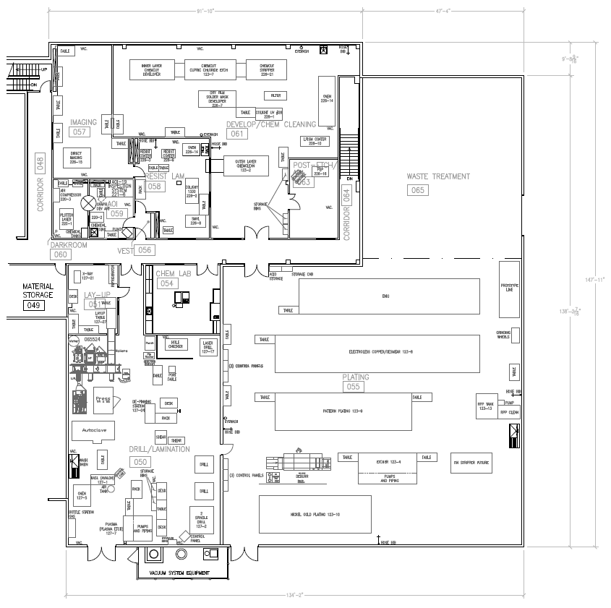
Additively Manufactured PCB
Floor plan for Crane facility approximately 16,000 ft²
3D Printer
Screen Print
Oven
Planarizer
Drill / Post Process
~250 ft²
Distribution Statement D: Distribution authorized to the Department of Defense and U.S. DoD contractors only.
Notes:
PCB’s are the foundation of most electronic systems.
Manufacturing is a complex sequence of photolithographic, chemical and mechanical processes using specialized equipment in a dedicated facility.
Generates waste – long lead times
This investigation explores combining 3D printing with conductive paste to yield:
Reduction in Process Steps – from >50 to < 10
Eliminate waste – no water or chemical processes
Facilitate point of use manufacturing – small foot print
Multipurpose equipment and materials

Slide 21
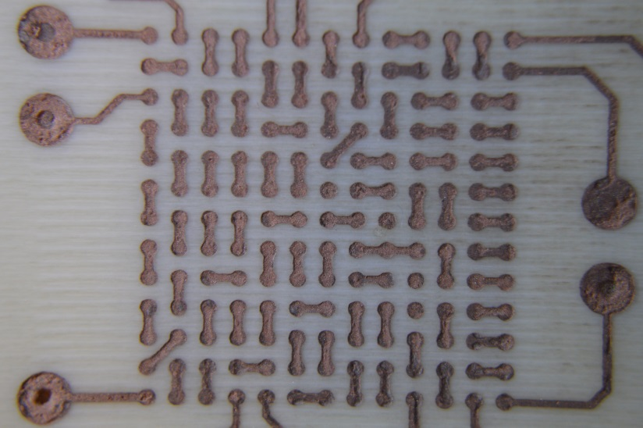
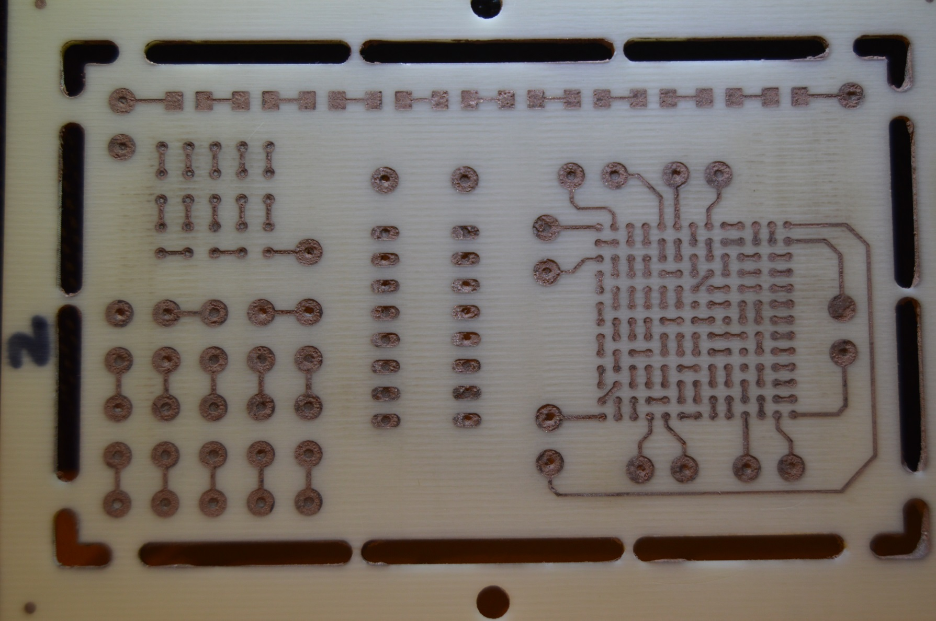
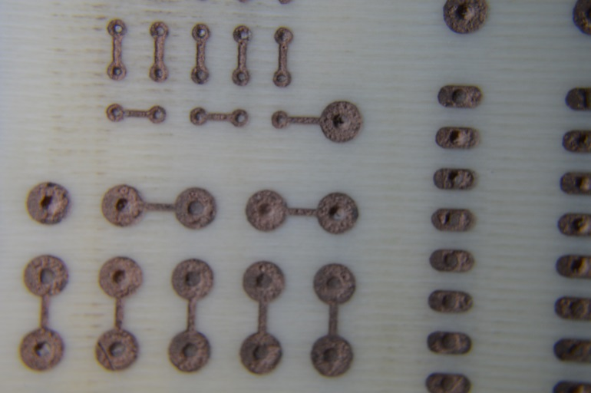
Additively Manufactured PCB
Patent No. US 10,070,532 B2
Distribution Statement D: Distribution authorized to the Department of Defense and U.S. DoD contractors only.
Notes:
Final result:
Pads, conductors, through connects
Ready for assembly
Assembled one sample using conductive silver adhesive
ABS like dielectric does not hold up to eutectic solder temperatures

Slide 22
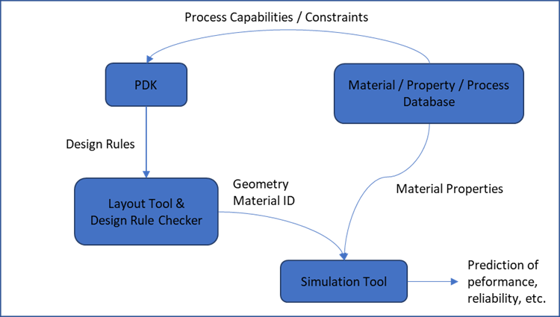
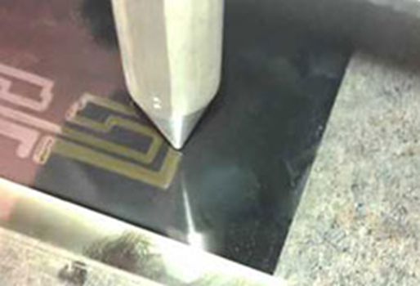
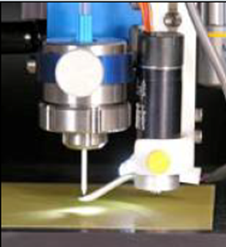
NextFlex DataCube
Problem:
Design cycle for Printed Electronics (PE) needs to evolve into an integrated design workflow
Processes are not standardized
Material properties vary with process conditions
Current design flow requires direct designer knowledge and fabrication process interaction
Linkage between material, process, and properties has been termed a “datacube”
NextFlex Manufacturing Innovation Institute has initiated the “DataCube Project” to address the material-process-property data gap through the creation of a database.
Figure 1: NextFlex vision for FHE Full Stack Design Flow
Figure 2: Aerosol Jet Printing
Distribution Statement D: Distribution authorized to the Department of Defense and U.S. DoD contractors only.

Slide 23
Contact
For questions please contact Steve Vetter
Office: (812)854-4074
Mobile: (812)227-9422
Email: stephen.vetter@navy.mil
Distribution Statement D: Distribution authorized to the Department of Defense and U.S. DoD contractors only.

